Slide 1
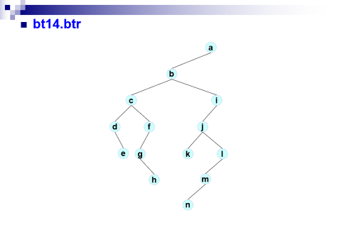
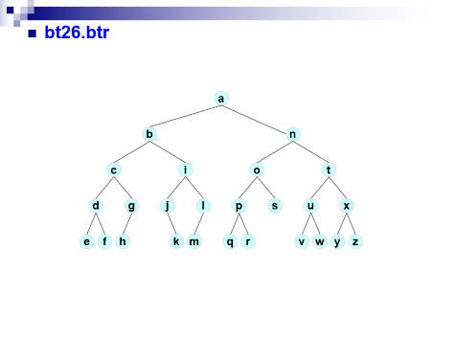
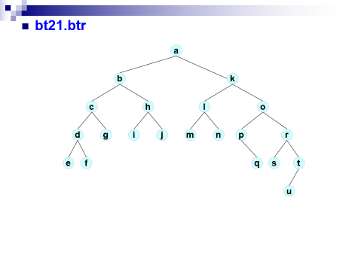
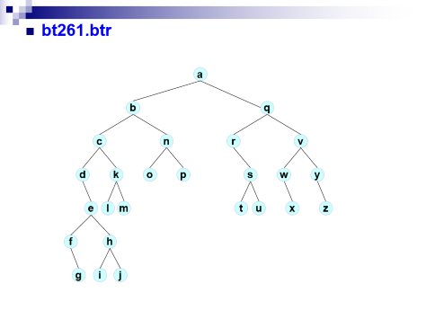
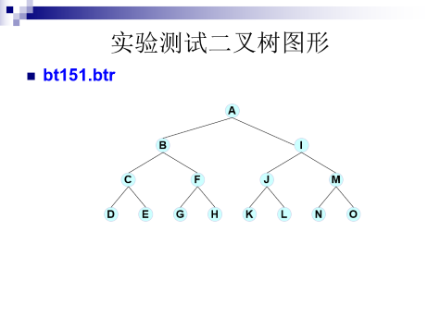
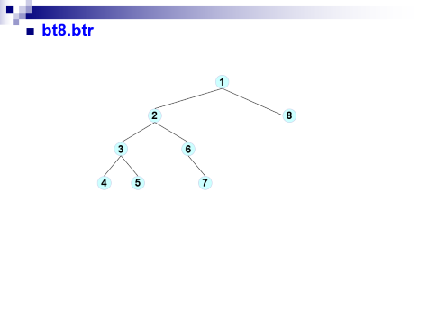
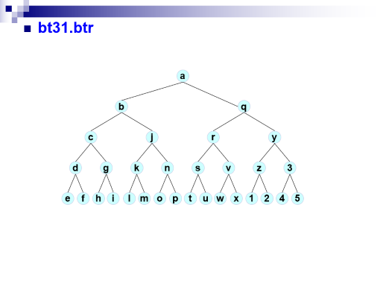

Slide 2
实验测试二叉树图形
bt151.btr
A
B
I
C
F
J
M
D
E
G
H
K
L
N
O

Slide 3
bt21.btr
a
b
k
c
h
l
o
d
g
i
j
m
n
p
r
e
f
q
s
t
u

Slide 4
bt14.btr
a
b
c
i
d
f
j
e
g
k
l
h
m
n

Slide 5
bt26.btr
a
b
n
c
i
o
t
d
g
j
l
p
s
u
x
e
f
h
k
m
q
r
v
w
y
z

Slide 6
bt8.btr
1
2
8
3
6
4
5
7

Slide 7
bt261.btr
a
b
q
c
n
r
v
d
k
o
p
s
w
y
e
l
m
t
u
x
z
f
h
g
i
j

Slide 8
bt31.btr
a
b
q
c
j
r
y
d
g
k
n
s
v
z
3
e
f
h
i
l
m
o
p
t
u
w
x
1
2
4
5

